Slide 1
Enterprise Network WAN Interconnection Overview

Slide 2
After years of development and evolution, the Internet has undergone significant changes. In the past, the Internet was centered on networks, and there were few Internet applications. As a major part of the network, the WAN takes the most important position on networks. However, the rise of cloud computing fully unleashes the potential of applications, and the Internet gradually becomes application-centric.
Traditional WAN interconnection focuses on connectivity, and there is no strict requirement for QoS or SLA. How can WANs evolve to meet requirements of the application-centric Internet?
After completing this course, you will be able to understand the development trend of WAN technologies and how to cope with the application-centric Internet.

Slide 3
Upon completion of this course, you will be able to:
Describe the challenges of WAN interconnection in the cloud era.
Illustrate basic SDN concepts.
Explain basic concepts of SD-WAN.
Describe Huawei SD-WAN Solution.

Slide 4
Situation of Enterprise WAN Interconnection
Challenges Faced by Enterprise WAN Interconnection
Emergence of SD-WAN
Huawei SD-WAN Solution Overview

Slide 5














What Is a WAN?
Wide Area Network (WAN) provides interconnection services between different regions, cities, and countries. A WAN usually spans a long distance (dozens of kilometers to thousands of kilometers). To meet long-distance transmission requirements of a WAN, optical fibers are often used as the interconnection media.
LAN
WAN
LAN
DC
Branch
ISP
Headquarters
Residents
Notes:
LAN
A local area network (LAN) is a computer network that connects computers, peripheral devices, databases, and other devices in a limited geographical area (such as a campus, factory, or organization) within thousands of meters.
WAN
WANs provide wider coverage than LANs and metropolitan area networks (MANs). The communication subnet of a WAN mainly uses the packet switching technology. The communication subnet of a WAN can use the public packet switching network, satellite communication network, and wireless packet switching network to interconnect the LANs or computer systems in different areas for resource sharing.
The Internet is the largest WAN in the world.
Relationship between the LAN and WAN:
A LAN is located in an area, whereas a WAN spans a larger area. For example, the headquarters of a large company is located in Beijing, and its branches are distributed all over the country. If the company connects all its branches through a network, a branch is a LAN, and the company network is a WAN.
Typical WAN rates range from 56 kbit/s to 155 Mbit/s. Currently, 622 Mbit/s, 2.4 Gbit/s, and even higher rates are available. The transmission delay ranges from several milliseconds to hundreds of milliseconds (when satellite channels are used).

Slide 6



WAN and Enterprise WAN Interconnection
Enterprise WAN interconnection refers to the interconnection between nodes at different levels, such as the headquarters, data centers (DCs), branches, fixed offices, and mobile offices.
Generally, enterprise WAN interconnection depends on a WAN built by a carrier or the self-built WAN.
Branch site
Branch site
HQ
Branch site
Enterprise WAN interconnection
Carrier network/Self-built network
WAN
Notes:
Enterprises that cannot build their own WANs usually lease ISP lines and use VPN or private line technologies to build enterprise WANs.
Enterprises that have WAN capabilities do not need to lease ISP lines except for Internet services.

Slide 7

Main Enterprise WAN Interconnection Modes
Generally, enterprise WANs can be interconnected in the following modes:
Carriers' MPLS or private lines are used to connect regional networks. This mode is applicable to enterprises with high SLA requirements and is expensive.
The carrier Internet + VPN technology is used for connection. This mode is applicable to small- and medium-sized branches that do not have high SLA requirements.
Carriers' point-to-point (P2P) private lines are used to implement cross-city or cross-border connections. This mode is mainly used for connections between DCs, headquarters, or important branches, and is expensive.
Industries such as electric power and transportation have network connections through self-built private lines.
Enterprise WANs usually use a combination of the preceding connection modes.
Enterprise WAN interconnection
HQ
HQ
Private line
MPLS
4G/5G
Internet
Self-built private network
Branch site
Branch site
Branch site

Slide 8
Enterprise WAN Interconnection Technologies - MPLS and Private Line
Private Line and MPLS Technologies
To ensure network reliability and security, enterprises lease MPLS or private lines from carriers when constructing enterprise WANs.
Private lines are expensive, but data is carried on dedicated lines, ensuring service quality and security.
Leasing MPLS lines from carriers is cheaper than private lines and can ensure service security. However, service reliability is not as good as that of private lines.
A small number of enterprises (such as transportation and electric power enterprises) have the capability of deploying optical fibers and can build their own backbone networks. For these enterprises, the cost of using MPLS or private lines is very low.
HQ
HQ
MPLS
MPLS
Optical fiber/SDH/MSTP/WDM
MPLS L2VPN/L3VPN
Branch site
Branch site
Branch site
Branch site

Slide 9

Enterprise WAN Interconnection Technologies - Internet and VPN
Internet and VPN technologies
With the development of the Internet, some enterprise services can be carried over the Internet.
The Internet is open, so VPN technology is used to provide secure and reliable connections.
Virtual Private Dial-up Network (VPDN) technologies, such as Point-to-Point Tunneling Protocol (PPTP), Layer 2 Tunneling Protocol (L2TP), and Point-to-Point Protocol over Ethernet (PPPoE), allow terminal users or branches to dial up to the carrier network or headquarters network.
Internet Protocol Security (IPsec) and Generic Routing Encapsulation (GRE) technologies are used to build networks between enterprise branches or between enterprise branches and the headquarters.
To simplify IPsec configuration on large-scale networks, technologies such as Dynamic Smart VPN (DSVPN) and Any to Any (A2A) VPN have been developed and widely used.
HQ
HQ
Internet
PPTP/L2TP/SSL VPN/IPsec VPN/DSVPN/A2A VPN
Branch site
Branch site
Branch site

Slide 10
Common Application Scenarios of Enterprise WAN Interconnection
Enterprise WAN interconnection needs to be deployed based on enterprise requirements. For example, in the financial industry, most enterprises lease private lines or MPLS lines to ensure reliability and security. Considering network costs, other enterprises usually lease MPLS lines as primary lines and Internet+VPN lines as backup lines.
WAN interconnection in the financial industry
WAN Interconnection for a wine enterprise
National core backbone high-speed backbone network
HQ
SDH/MSTP/MPLS
Branch service network
Level-1 branch
MPLS (primary)
Internet (backup)
Branch LAN
SDH/MSTP/MPLS
GRE over IPsec
Branch LAN
Level-2 branch
Level-2 branch
SDH/MSTP/MPLS
Sub-branch
Sub-branch
ATM
Sub-branch
Branch in area A
Branch in area B
Branch in area C

Slide 11
Situation of Enterprise WAN Interconnection
Challenges Faced by Enterprise WAN Interconnection
Emergence of SD-WAN
Huawei SD-WAN Solution Overview

Slide 12
Challenges to Enterprise WAN Interconnection Brought by Cloud Computing
Before cloud computing is introduced, there are a few network applications, and the network service quality can be ensured only by expanding the bandwidth. Service traffic does not need to be managed in a refined manner. The Internet is mainly built based on the network.
With the advent of cloud computing, the number of network applications is greatly increased. As a result, it is difficult for enterprises to strike a balance between line prices and service quality in the face of soaring traffic.
HQ
WAN
Increasing enterprise services
Branch site
Branch site
Branch site
Notes:
To ensure the reliability of some key services on the cloud, enterprises usually lease carriers' private lines to carry these services. However, with the increase of enterprise services, enterprises face the following problems:
A large amount of bandwidth is required to migrate services to the cloud. High-bandwidth private lines, especially cross-province and cross-border private lines, are expensive.
If the Internet is used to build VPNs, the cost can be reduced, but the reliability of key services cannot be ensured.
If key services need to be carried on private lines and common services need to be carried on Internet, the configuration is complex and difficult to control.

Slide 13
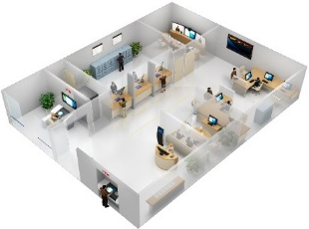


Challenges to Enterprise WAN Interconnection Brought by Multiple Services
Enterprises have poor service traffic awareness capabilities and cannot effectively guarantee key services. In addition, the monitoring capability of service traffic is insufficient, and service traffic cannot be quickly adjusted.
No application visibility; difficult traffic scheduling
Key services such as voice, video, and SaaS are difficult to manage.
600+
Priority conflict: Key applications cannot be identified, and the scheduling priority is low.
Bandwidth conflict: During peak hours, the burst traffic is three to five times the average traffic, affecting key applications.
Primary MPLS link, congestions during peak hours
Unknown application
Inter-WAN applications
(an enterprise)
HQ
Services of SaaS applications are transmitted through the headquarters, resulting in a long delay.
Cloud
Cloud
Cloud
Unknown application
Cloud
Backup Internet link, low bandwidth utilization
Idle bandwidth, and smooth video conference
Bandwidth conflict, video conference frame freezing
Notes:
Existing traditional technologies cannot effectively monitor the actual traffic of services.
Traditional network management technologies (SNMP) can only monitor interface bandwidth usage.
The interface usage cannot be monitored based on service applications, and the quality of key services cannot be detected.
Service applications cannot be detected, and therefore services cannot be precisely controlled.

Slide 14
Challenges to Enterprise WAN Interconnection Brought by a Large Number of Branches
With the development of companies, there will be more and more cross-city, cross-province, and cross-border branches. As a result, companies face the following problems in branch network management:
Too many branches result in high O&M costs.
It takes a long time to provision new branch services.
It is difficult to rectify faults on branch networks.
Long period taken to provision new branch services
Difficult troubleshooting of branch networks and high O&M costs
Business consideration and device selection
(1–3 days)
Hardware installation
(1–3 days)
Software commissioning
(1–3 weeks)
Network planning
(2–5 days)
Process approval
(2–5 days)
Hardware transportation
(2–5 days)
Site survey
(1–3 days)
Branch 1
Branch site
Branch site
Branch site
Branch 2
Branch site
…
Branch 3
Notes:
Software-defined networking (SDN) technology can be used to address the challenges brought by existing services to enterprise WANs.

Slide 15
Situation of Enterprise WAN Interconnection
Challenges Faced by Enterprise WAN Interconnection
Emergence of SD-WAN
Huawei SD-WAN Solution Overview

Slide 16
What Is SDN?
SDN Overview
SD-WAN Characteristics
Core Values of SD-WAN
SDN decouples the forwarding plane, control plane, and service applications, allowing networks to be quickly adjusted and new services to be quickly deployed in the same way as IT applications.
Service applications
SDN controller
Unified management
Branch site
Branch site
ISP network/Enterprise-built network
HQ
Branch site
Forwarding plane

Slide 17
SDN Advantages
SDN Overview
SD-WAN Characteristics
Core Values of SD-WAN
SDN reconstructs the network architecture, and is not a new feature or function.
SDN overcomes the disadvantages of traditional networks.
Disadvantages of traditional networks
Advantages of the SDN network
The network architecture is distributed. A network device is a closed system consisting of hardware, an operating system, and network applications, and control and data forwarding functions are tightly coupled.
Disadvantages:
Low network flexibility
Complex network protocols
Heavy dependency on network device vendors
Difficult O&M management
SDN provides a new network architecture that separates the network control function from the forwarding function and implements programmable control.
Advantages:
Network virtualization
Network automation
Rapid service provisioning
Openness and programmability

Slide 18
SDN Architecture
SDN Overview
SD-WAN Characteristics
Core Values of SD-WAN
Service layer
The service layer is the interaction interface at the top of the SDN architecture. It consists of various network application services and is responsible for understanding users' service requirements and orchestrating network services based on user requirements.
Control layer
The control layer is the brain of SDN. It opens abstracted network functions and services to the application layer through northbound interfaces and controls the forwarding behavior of underlying network devices through southbound interfaces.
Infrastructure layer
The infrastructure layer can be regarded as the core of the SDN architecture and consists of various common network devices. These network devices forward traffic based on the policies delivered by the control layer.
Service layer
Service applications
API
API
API
Control layer
Network services
SDN controller
Control/Forwarding communication interface
Infrastructure layer
Network device
Network device
Network device
Network device
Network device
Notes:
The SDN network architecture is provided by the Open Network Foundation (ONF).
The SDN architecture can be divided into three layers from top to bottom: service layer, control layer, and infrastructure layer.

Slide 19
Emergence of SD-WAN
SDN Overview
SD-WAN Characteristics
Core Values of SD-WAN
Software-defined WAN (SD-WAN) integrates SDN and WAN. It applies the SDN architecture and concepts to WANs and reshapes WANs with SDN.
Uses Zero Touch Provisioning (ZTP) to implement fast deployment and rollout of branches, improving deployment efficiency.
Dynamically adjusts traffic paths by application type, making traffic steering more flexible and convenient.
Provides centralized management and control, network-wide status visualization, and automatic and intelligent O&M capabilities.
Provides VASs such as WAN optimization and security, and implements fast service provisioning.
Top 10 SD-WAN requirements defined by the ONU
SD-WAN features defined by Gartner
SD-WAN characteristics
SD-WAN features defined by Metro Ethernet Forum (MEF)
Notes:
The Open Networking User Group (ONUG) is an influential user organization led by large enterprises and mainly used by IT users. It is established by IT technology executives of well-known large enterprises in North America, and is dedicated to IT implementation and network technology transformation of large enterprises. ONUG members include large enterprises in industries such as finance, insurance, medical care, and retail. ONUG is a platform for high-end customers in North America to discuss and communicate IT requirements.
Gartner is world's most authoritative IT research and consulting company, covering all IT industries. Gartner provides objective and fair demonstration reports and market research reports for customers in terms of IT research, development, evaluation, application, and market, and assists customers in market analysis, technology selection, project demonstration, and investment decision-making.

Slide 20
Notes:
MEF is a non-profit organization focusing on metro Ethernet technologies. It aims to promote wide use of Ethernet technologies as switching and transmission technologies in metro network construction. MEF aims to promote the implementation of existing and new standards, Ethernet service definitions, test procedures, and technical specifications, so Ethernet-based MANs can become carrier-class networks. MEF also provides lifecycle service orchestration (LSO)-based solutions and architectures for carriers' managed service markets, and defines northbound interfaces (NBIs) to implement multi-vendor interconnection and interworking.

Slide 21

Characteristics of SD-WAN: Hybrid Links
SDN Overview
SD-WAN Characteristics
Core Values of SD-WAN
Flexible IP overlay network based on hybrid WAN links
HQ
HQ
Virtual network 1
Virtual network 2
Carrier private line
Carrier private line
Carrier private line
Internet
Virtual network (overlay network)
HQ edge
MPLS
Branch edge
Branch
Branch
Internet
Branch edge
Branch edge
Traditional WAN
Hybrid WAN
Physical network (underlay network)
Notes:
Traditional WANs are interconnected through private lines provided by carriers. With the improvement of Internet quality and expansion of coverage, the Internet can be used as a new WAN technology. In addition to MPLS private lines provided by carriers, enterprises can also use the Internet for WAN branch interconnection to implement hybrid WAN interconnection, effectively reducing WAN deployment costs and improving WAN usage efficiency.
To implement the hybrid WAN, some key network technologies are required, that is, IP overlay and VPN technologies. IP overlay technology uses the IP tunnel encapsulation technology to encapsulate service traffic into tunnels so that the traffic can transparently traverse different WAN links. IP overlay technology cannot isolate the user overlay network from the carrier underlay network, so VPN is used. VPN adds an additional VPN field to IP packets to identify different network domains. In this way, the private network of an enterprise is isolated from the public network of a carrier, and even different private networks of an enterprise are isolated from each other. IP overlay and VPN are usually deployed together.

Slide 22

Characteristics of SD-WAN: Plug-and-Play
SDN Overview
SD-WAN Characteristics
Core Values of SD-WAN
Device plug-and-play, achieving fast service rollout
Multi-tenant management
iMaster NCE-WAN
Subscription and self-service
MSP/Carrier
Enterprise
Perform operations on devices in batches in the warehouse and deploy them in a centralized manner.
It applies to scenarios where multiple access modes are used, and the configuration is completed in one click.
There is no skill requirement onsite in DHCP scenarios.
USB-based deployment
Email-based deployment
DHCP-based deployment
Plug-and-play implemented in multiple modes
Carrier network
Device deployment and onboarding
Notes:
New branches of an enterprise need to go online quickly. After devices are delivered to the site, common personnel at the site can use the plug-and-play function to provision the branch network without professional network skills. To achieve this, a centralized network control system is required to register network devices upon power-on and manage them, and to automatically and remotely deliver network configurations required by devices at the site on demand, implementing fast branch service rollout. For example, the network control system may send an email to a deployment engineer, and the email includes configuration of a site device. Deployment personnel connect and power on devices at the site, and load the configuration in the email to the devices through simple operations. Then the devices automatically register with the network control system.
The plug-and-play mode effectively reduces skill requirements for deployment personnel and shortens the time for provisioning and adjusting branch services from several days or even months to hours, greatly improving flexible service provisioning of branch networks.

Slide 23
Characteristics of SD-WAN: High Performance
SDN Overview
SD-WAN Characteristics
Core Values of SD-WAN
High-performance branch devices are used to process all services including application-centric services.
Functions of pure routing
SD-WAN functions
Multi-scenario interconnection
1
Forwarding performance
Various networking modes
Application identification
Dynamic link adjustment
DPI & FPI
QoS & adjustment
L3-L7
Application
Traffic management
Enterprise private line
QoS
VPN
L1-L3
Package
QoS
VPN
Traditional WAN
SD-WAN
Monitoring
VPN & Firewall & WOC
After SD-WAN is enabled,
the forwarding performance deteriorates sharply.
80%
Routing
Simplified O&M
VPN & multi-VAS
Routing
WAN interconnection
Requirements on forwarding performance
The performance bottleneck of routers is the key factor that restricts large-scale commercial deployment of SD-WAN.
Requirements on forwarding performance
Notes:
Based on the "multi-core CPU+NP" forwarding architecture, high-performance branch devices use professional NP chips to implement fast forwarding of L2-L4 traffic and efficient QoS processing. With open programmability of the multi-core CPU, high-performance branch devices can integrate various hardware-based intelligent acceleration engines, for example, hierarchical QoS (HQoS), application identification, and IPsec acceleration, and import them to chips to provide high-performance processing capabilities for L3-L7 services.

Slide 24
Characteristics of SD-WAN: Automatic Network Orchestration
SDN Overview
SD-WAN Characteristics
Core Values of SD-WAN
Service- and intent-orientation, implementing network orchestration and automatic provisioning.
Traditional network
Traditional network service provisioning requires professional network engineers to perform planning, configuration, and O&M, and then run commands or use the NMS software to configure devices one by one based on the planned services.
iMaster NCE-WAN
Propose requirements
Enterprise
Provision services
Branch site
SDN network
The SDN network uses a centralized network control system to abstract, orchestrate, and automatically provision network services on demand. It shields technical implementation details of the network and opens only service-oriented interfaces and parameters to users.
Branch site
IP overlay tunnel
IP overlay tunnel
HQ
Branch site
IP overlay tunnel
Enterprise WAN interconnection
Notes:
For example, an enterprise wants to connect multiple branches through the headquarters. Traditionally, network parameters, such as interfaces, IP addresses, routing protocols, security, and VPN, are manually configured on each branch device. If there are 100 sites, devices need to be configured one by one. In addition, you need to configure special routes for the headquarters to forward all traffic. The entire process is complex and requires operators to be familiar with network technical details such as switching and routing. Service provisioning is slow and manual operations are prone to errors.
In SD-WAN, assume that a centralized network control system serves as the control center of the network and can manage all branch devices. The network control system, as the brain of the network, displays a network connection operation primitive that can be understood by a non-network professional user. For example, a user's instruction is to enable 100 sites, and the headquarters site is used for interconnection, and the user does not need to enter network-level parameters. After receiving the request, the network control system automatically translates the original network connection requirement into traditional network configuration operations that can be understood by network devices, that is, operations such as routing and VPN that are manually performed in the traditional method. Then it further transmits the operation to the devices at the branch site, thereby implementing automatic provisioning of network services. The entire network service provisioning process is automatically completed by the network control system, which effectively lowers the network skill requirements of users and reduces network operations. In addition, automatic conversion of the network control system is not error-prone, which greatly improves the WAN service provisioning efficiency and user experience.

Slide 25


Characteristics of SD-WAN: Efficient Cloud Interconnection
SDN Overview
SD-WAN Characteristics
Core Values of SD-WAN
On-demand and efficient cloud connection
Connecting to a public cloud
Connecting to the SaaS cloud
A cloud site requires an NFV-based device as a gateway to connect enterprise branches to the public cloud. Devices on the cloud remotely schedule public cloud APIs and resources through the centralized network control system to connect devices on the cloud to the branch network.
Enterprises can access remote SaaS applications on the cloud through the WAN in the following ways: 1. Internet 2. Direct access through MPLS 3. Headquarters
SaaS applications on the cloud
MPLS
Branch
HQ/DC
Internet
MPLS
Internet
Branch
Public cloud
Branch
HQ/DC
Notes:
With the advent of the cloud era, enterprise WANs need to open the traditional closed network architecture and flexibly connect various cloud resources. Cloud resources closely related to enterprise WANs include IaaS basic cloud services and SaaS cloud applications. With the popularity of public clouds, more and more enterprises are considering migrating their IT systems to public clouds. An enterprise's system in the public cloud can be considered as a special branch site, that is, a cloud site. A cloud site also requires a device that functions as a gateway to connect enterprise branches and the public cloud. Because the device is deployed on the cloud, the device must be based on NFV. Devices on the cloud need to be quickly created and connected to enterprise branch sites in real time. Therefore, a centralized network control system is required to remotely schedule public cloud APIs and resources, automatically start devices on the cloud, and connect the public cloud and branch networks.
To access SaaS applications efficiently, SD-WAN needs to have the capability of optimizing SaaS access paths. When an enterprise accesses a remote SaaS application on the cloud through the WAN, multiple paths may be available, for example, access through an Internet, an MPLS network, or the HQ. A branch needs to be capable of perceiving network Service Level Agreement (SLA) quality of each optional path in real time, with the help of the centralized network control system. It can adjust and select the optimal SaaS access path in real time.

Slide 26

Characteristics of SD-WAN: Intelligent Traffic Steering
SDN Overview
SD-WAN Characteristics
Core Values of SD-WAN
Intelligent traffic steering, ensuring application experience
The introduction of hybrid WAN provides multiple WAN links for enterprise service traffic.
Different WAN links have different network quality. High-value applications are preferentially transmitted through high-quality WAN links. In this case, route selection based on application SLA needs to be implemented.
3
2
1
5
4
CPE
CPE
Before switching
3
2
1
CPE
5
4
CPE
After switching
High link quality
Notes:
The introduction of hybrid WANs provides multiple WAN links for enterprise service traffic. Different WAN links offer varying levels of network quality. For example, the price of MPLS private lines is high and the corresponding link SLA quality is guaranteed. Although Internet links are improved greatly and can carry applications that support high bandwidth, the delay and packet loss occur frequently on Internet links and SLA is not guaranteed, making the Internet unsuitable for delay-sensitive voice and video services. The solution to this issue is to implement link selection based on the SLA quality requirements of applications. Specifically, the quality of different WAN links is measured, and the requirements of applications regarding network quality (such as packet loss rate, delay, and jitter) are defined. Among all WAN links that meet SLA requirements of applications, enterprise users can define route selection policies to preferentially transmit high-value applications through high-quality WAN links. For example, voice traffic (high-value traffic) is preferentially transmitted over high-quality MPLS links. The network has the capability of dynamically adjusting paths. When the MPLS link quality deteriorates and does not meet application SLA requirements, the network can automatically switch voice traffic to another WAN link that satisfies application SLA requirements.

Slide 27
Characteristics of SD-WAN: WAN Optimization
SDN Overview
SD-WAN Characteristics
Core Values of SD-WAN
WAN optimization, improving WAN link quality
When the quality of a WAN link deteriorates, for example, packet loss or long delay occurs, WAN optimization technologies need to be used to improve network fault tolerance and ensure data transmission quality. Common WAN optimization technologies include transmission optimization, data optimization, and packet loss concealment optimization.
Add redundancy error correction packets.
VoIP traffic
Internet
Original packet
HQ/DC
Branch
Enable WAN optimization.
Notes:
The prerequisite for application-based traffic steering is that there are WAN links that meet SLA quality requirements. When the quality of a WAN link deteriorates, for example, packet loss and long delay occur, WAN optimization technologies need to be used to improve network fault tolerance and ensure data transmission quality. Common WAN optimization technologies include transmission optimization, data optimization, and packet loss concealment optimization.
Forward Error Correct (FEC), a common packet loss concealment technology, is used as an example to describe the value of WAN optimization. The core of FEC is to improve the fault tolerance of application data to links with deteriorated quality by reconstructing or optimizing the data transmission protocol. FEC packets are encapsulated in normal data flows to record packet digest information. During data transmission, some service packets are lost due to packet loss on the network. At the receive end, the device can restore the lost packets based on the FEC field to ensure the integrity of data transmission.
The core of WAN optimization is to use extra compute or storage resources to improve network transmission performance and application experience. WAN optimization is an effective technical means to ensure that user service experience is not affected when the link quality deteriorates on an enterprise WAN.

Slide 28
Characteristics of SD-WAN: Secure Interconnection, Visualized O&M, and Open Interfaces
SDN Overview
SD-WAN Characteristics
Core Values of SD-WAN
Secure and reliable interconnection
Open APIs
Centralized management/control and visualized O&M
SD-WAN must provide system and service security. The network devices, control system, and services transmitted in SD-WAN must have basic security protection capabilities such as attack defense.
In the northbound direction, the network controller provides open and programmable RESTful interfaces to implement SD-WAN integration and customization by third parties.
In the network control system, the central dashboard displays key network performance data, bandwidth proportion of key applications, and application health scores.
HQ
GUI
OSS/BSS
Analysis system
Third-party VAS
Other applications
Northbound interface
RESTful API
SD-WAN
Network
SD-WAN
Controller
Encryption channel
SD-WAN
Controller
NETCONF/SSH
BGP/DTLS
HTTP/2
Centralized management and control
Southbound interface
Performance data
Branch site
CPE
vCPE
IWG
CPE
vCPE
IWG
Notes:
Secure and reliable interconnection
The transmission of enterprise WAN application data requires security assurance, including system security and service security.
System security includes the security of network devices and network control systems, which must be connected to the WAN and may also be connected to the Internet. Because of this, they must have basic security protection capabilities, such as attack defense.
For enterprise services, service data is transmitted on the WAN. Therefore, authentication and encryption are required to prevent data leakage.
Centralized management, visualization, and easy O&M
Enterprises use the centralized management and O&M system. This system must be able to remotely manage branch devices, as well as display the WAN topology and remotely monitor alarms, logs, and other key event information of each branch device in real time.
In the centralized network control system, the central dashboard displays key network performance data, bandwidth proportion of key applications, and application health scores.
Northbound open APIs
The network controller provides open and programmable northbound RESTful interfaces. Third-party BSS/OSS software interconnects with the network controller through northbound APIs.

Slide 29
Core Values of SD-WAN
SDN Overview
SD-WAN Characteristics
Core Values of SD-WAN
Powerful interconnection
Optimal experience
High performance
Easy O&M
Flexible networking for on-demand interconnection of multiple clouds and multiple networks
Mesh, hub-spoke, and partial-mesh
Various WAN interfaces, such as Ethernet, LTE, 5G, and DSL
Interworking between the traditional network and MPLS network
Flexible Internet access
Application-based traffic steering and optimization ensure key application experience
Intelligent application identification
Flexible and dynamic route selection
QoS
WAN optimization
High-performance branch devices build a new forwarding engine
New applications, especially high-bandwidth applications such as video, increase.
Network devices require more software functions, from L1-L3 to L1-L7, and have higher requirements on CPE performance.
Intent-driven simplified branch network O&M
Automatic orchestration and easy configuration
Automatic discovery and easy O&M
Openness and easy integration
Visualized O&M, reducing labor costs
The core of SD-WAN is to help enterprises flexibly and conveniently obtain a high-quality WAN network with powerful interconnection, optimal experience, high performance, and easy O&M anytime and anywhere. SD-WAN is a good solution to the problems faced by enterprise WANs.
Notes:
Powerful interconnection: flexible networking for on-demand interconnection of multiple clouds and multiple networks
SD-WAN flexibly uses hybrid links, such as optical fibers, DSL links, and LTE links, to quickly provision networks and reduce link costs.
In addition, SD-WAN provides a broad variety of networking models, including hub-spoke, full-mesh, partial-mesh, hierarchical networking, and IaaS/SaaS access, meeting requirements of different enterprise services.
Optimal experience: Application-based traffic steering and optimization ensure key application experience
SD-WAN can monitor the quality of multiple links in real time, detect link connectivity, and record the packet loss rate, delay, jitter, and other real-time status information.
SD-WAN also provides multiple application identification methods to accurately identify application information in traffic.
High performance: High-performance branch devices build a new forwarding engine.
In contrast to traditional enterprise branch devices that feature packet forwarding at Layers 1 to 3, SD-WAN branch devices deliver application-based full service processing at Layers 3 to 7. Their high-performance forwarding capabilities help enterprise branches build a new forwarding engine to allow enterprise services to operate normally.

Slide 30
Notes:
Easy O&M: intent-driven simplified branch network O&M
SD-WAN inherits the two basic design concepts of SDN: centralized control and intent-driven. This makes it possible to implement intent-based centralized management and control on the entire network. Based on centralized control, SD-WAN provides the network-wide monitoring function to obtain branch link status in real time, making the network-wide status visualized.

Slide 31
Situation of Enterprise WAN Interconnection
Challenges Faced by Enterprise WAN Interconnection
Emergence of SD-WAN
Huawei SD-WAN Solution Overview

Slide 32









Architecture of Huawei SD-WAN Solution
Solution Architecture
Solution Highlights
Customer benefits
Key technologies
...
5G uplink: All CPE series support 5G.
Large bandwidth: 230 Mbit/s for uplink and 2 Gbit/s for downlink
Full frequency: 5G/4G/3G/2G
Dual-architecture: full support for NSA/SA
High performance: no congestion during forwarding
CPU+NP heterogeneous forwarding architecture
High performance, meeting SD-WAN development requirements in the next five years
Optimal experience: intelligent traffic steering, ensuring experience of key applications
Application-based intelligent traffic steering, on-demand 5G+fiber scheduling
A-FEC ensures that no frame freezing or artifact occurs in case of 20% video packet loss.
Easy O&M: full-process automation and plug-and-play
Multiple ZTP modes, and branch network deployment in minutes
Visibility of application, branch, device, and link status, centralized management, and simplified O&M
Enterprise value
Reduced O&M cost
Improved WAN usage
Cloud app
Self-service portal
VAS store
Carrier value
Minute-level service provisioning (location independent)
Improved O&M efficiency: cloud management & automation
Revenue increase
Extended B2B service domain: VAS, connectivity
managed LAN
Smooth evolution, openness, and quick integration
RESTful API, uCPE/vCPE
Optimization
Subscription
O&M
Deployment
Adjustment
Automation
Insight
Visualization
Hybrid WAN
Branch 1
...
Internet
Edge
Public cloud
Edge
xDSL/Ethernet
/LTE...
HQ/
DC site
MPLS
Edge
ERP, video...
Branch 2
Edge
LTE
Traditional network
WG

Slide 33

Flexible Networking and Forwarding-Control Separation
Solution Architecture
Solution Highlights
Forwarding-control separation architecture
Distributed control components are deployed on the CPE or cloud as required, simplifying the network control topology.
Large-scale networking and flexible expansion
vRR
Distributed and on-demand vRR expansion
Two deployment modes: independent deployment/co-deployment
CPE
Smooth capacity expansion on demand
Distributed control component
Flexible networking
On-demand orchestration of 20+ networking models
Full-mesh, partial-mesh, hub-spoke, area-based networking, and hierarchical networking
Dual-CPE & multi-link, multi-PoP, etc.
Full-mesh
MPLS
Internet
Hub-spoke
CPE
PoP
Tunnel
PoP
CPE
Partial-mesh
MPLS
Internet
LTE
Interlink
Dual-CPE & multi-link
CPE
CPE
One logical CPE
Multi-PoP E2E overlay
Dual-CPE & multi-link

Slide 34


High Availability of Branch Interconnection Services
Solution Architecture
Solution Highlights
E2E reliability design ensures high availability of branch interconnection services
MPLS
Internet
HUB1
HUB2
VRRP
Controller cluster
MPLS
Internet
Controller (master)
Controller (slave)
Route switching
MPLS
Internet
CPE redundancy
Multi-link redundancy
Hub redundancy
Controller redundancy
Two CPEs at a site back up each other, and they support VRRP or route switchover.
Underlay link redundancy is supported. When a link is faulty, services are automatically switched to other links.
The solution supports two CPEs at a single hub and dual hubs. When the hub is faulty, the site node automatically switches to the backup hub.
The cluster is deployed, providing high reliability, remote disaster recovery, and automatic switchover.

Slide 35

Guaranteeing User Experience in Key Applications
Solution Architecture
Solution Highlights
Three identification engines and intelligent identification of network-wide applications at layers 3 to 7
Application experience-prioritized, supporting comprehensive route selection considering bandwidth and link quality
VIP application (video)
MPLS (20 Mbit/s)
Low-priority application
SaaS FPI
Office 365 and Salesforce, correct route selection at one time
VIP application
80%
50%
SA for complex applications
6000+ applications (such as VoIP and videos), accurate identification
Branch
Internet (100 Mbit/s)
Identification of customized applications
URL-based, 5-tuple-based, and DSCP customization
Identification of enterprises' private applications
Application quality-based route selection
Load balancing based on link bandwidth
Bandwidth utilization-based route selection
If the bandwidth usage of the primary link group is higher than 80%, low-priority applications are switched to the backup link group.
If the bandwidth usage of the primary link group is less than 50%, low-priority applications are switched back to the primary link group.
Enterprise branch
The identification rate of all services from Layer 3 to Layer 7 is doubled.

Slide 36


Intelligent A-FEC — 20% Packet Loss and No Frame Freezing
Solution Architecture
Solution Highlights
Networked Environment | Packet Redundancy Rate | Before Optimization | After Optimization
30 Mbit/s + 65 ms delay + 5% packet loss | 7% | No frame freezing and low definition | No frame freezing and high definition
30 Mbit/s + 65 ms delay + 10% packet loss | 11% | Artifact and frame freezing | No artifact or frame freezing
30 Mbit/s + 65 ms delay + 20% packet loss | 22% | Serious artifact and frame freezing | No artifact or frame freezing
AR router
(built-in WOC)
AR router
(built-in WOC)
Internet
Branch 1
Original packet
Redundancy packet
Branch 2
A-FEC: The FEC protection window and protection mode are automatically and dynamically adjusted based on the link quality.
Detect link quality in real time
and adjust the FEC protection window as required.
Packet loss during transmission
Enable FEC on the receive device
and restore the original video packet.
Huawei 20%packet loss, no frame freezing, no artifact
Third party:3% packet loss and artifact
Intelligent A-FEC, Low Overhead, and High-quality Experience
Redundancy coding is performed on historical frame information. After normal frames are sent, the corresponding redundancy frame is forwarded. The receive end can use the received redundancy frame to restore the lost packet.
Huawei adaptive-FEC (A-FEC) uses the intelligent data analysis engine to adjust the FEC protection window and protection mode based on the link quality to achieve high recovery and low redundancy.

Slide 37

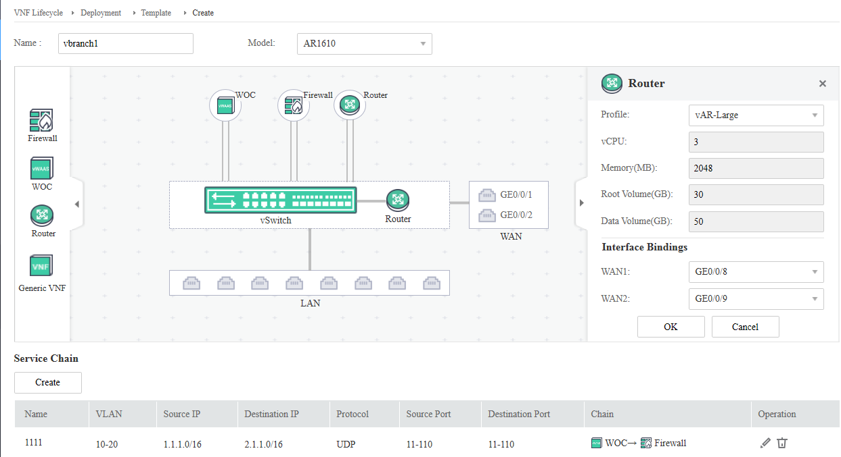
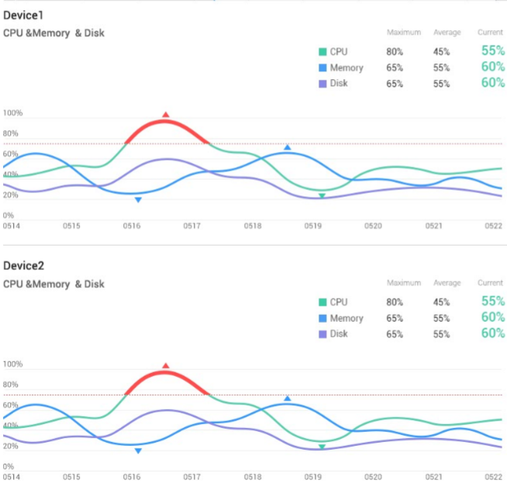



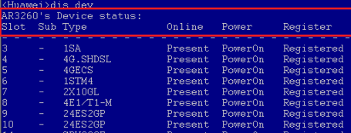

Full-Process Automation
Solution Architecture
Solution Highlights
vCPE acquisition
Email
USB flash drive
ESN
Hub
vCPE deployment
Spoke
Spoke
…
IaaS/SaaS connection
Spoke
Overlay tunnel
CPE deployment automation
ZTP
Cloud interconnection automation
Automatic IaaS/SaaS interconnection configuration
Overlay tunnel automation
Dynamic tunnel orchestration based on traffic policies
Automated service chain orchestration for VNFs
VAS provisioning in minutes
O&M automation
Network-wide visualized and automatic O&M
Full-process automation of enterprise interconnection
iMaster NCE-WAN: automation and visualization
Various built-in networking templates
Configuration process guidance
Drag-and-drop
Traditional WAN: CLI

Slide 38
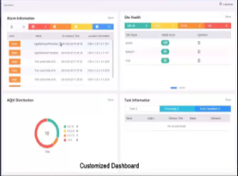
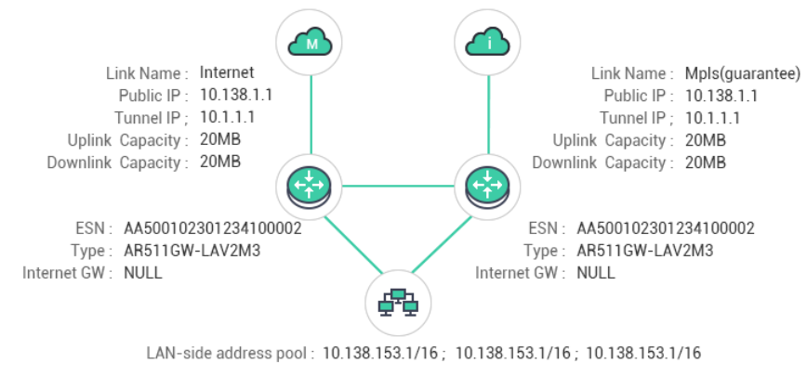
Visualized O&M
Solution Architecture
Solution Highlights
Quickly obtain abnormal traffic
Quickly locate faulty devices or sites
Optimize WAN investment and configuration policies
Real-time alarm monitoring
User-defined dashboard (role or preference)
Network-wide real-time alarms (minute-level)
Topology status visualization
Topology display based on sites and links
Enterprises obtain the status and performance information of sites and links in real time.
45+ user-defined views
Site/Link/Application/Device/User health view
Site bandwidth utilization
Sites with Top N throughput
Top N application traffic
Link throughput trend

Slide 39
(Multiple-answer question) Which of the following are disadvantages of traditional WANs?
Low network flexibility
Complex network protocols
Enterprises are highly dependent on network device vendors.
Difficult O&M
Notes:
1. ABCD

Slide 40
Generally, enterprise WAN interconnection depends on WANs built by carriers or self-built WANs.
After services are cloudified, flexible networking and fast service optimization are required.
Huawei SD-WAN Solution uses iMaster NCE-WAN to quickly deploy networks and uses devices to detect applications and flexibly select paths.

